Slide 1
S:\HA<KS 2021
Notes:
Change the slide background colour to any of the Primary colours (except yellow)

Slide 2

Agenda
01
02
03
04
Communications Breakdown
Problem Space
Submission Guidelines
Prizes

Slide 3



Main Comms
Communications Breakdown
A discord server has been set up as the primary method of communication
Teams can communicate with:
Each other
Other hackers/participants
Mentors (each team has one!)
Events & Workshops
All events hosted by the Campus Team will be held on Microsoft Teams
Links are available in the Airtable Toolkit and through discord reminders
Airtable Toolkit
When in doubt, give Airtable a shout
Notes:
When everyone is together, we’ll be using teams

Slide 4
Problem Space
Create a solution that could be adopted by Scotiabank which would improve accessibility to online financial services and minimize the digital divide in our society as technology rapidly advances.
What is Digital Divide?
Why is this important?
Describe discrepancies between social groups in access to, use of, and empowerment by digital tools (computers, phones, etc.)
For the purpose of this hackathon, focus your solution to Canadian societies
The internet provides opportunities to overcome or exacerbate existing inequalities
Individuals without internet and access to tech tools are at a disadvantage
Scotiabank is heavily invested in developing an inclusive society
Notes:
SIS – Situation Impact Statement

Slide 5
Problem Space Resources
Create a solution that could be adopted by Scotiabank which would improve accessibility to online financial services and minimize the digital divide in our society as technology rapidly advances.
United Nations – Technology and its Inequality
Forbes – Digital Divide and its impact on Banking
NBER – Epidemic Exposure, Fintech Adoption, and the Digital Divide
TedTalk - Financial Inclusion & Digital Divide with Ajay Banga
CBC - Digital Divide and its Impact on Indigenous Communities

Slide 6



Submission Guidelines
Vidyard Virtual Recording Software
Screen, audio, and camera recording software
Make an account here
Content Recommendations
Rubric used by judges
Found in the Airtable Toolkit
More tips/tricks will be shared at “How to Succeed at Hackathons (Technical)”
Presentation Timeframe
5-minute limit
Keep the judges hooked!

Slide 7
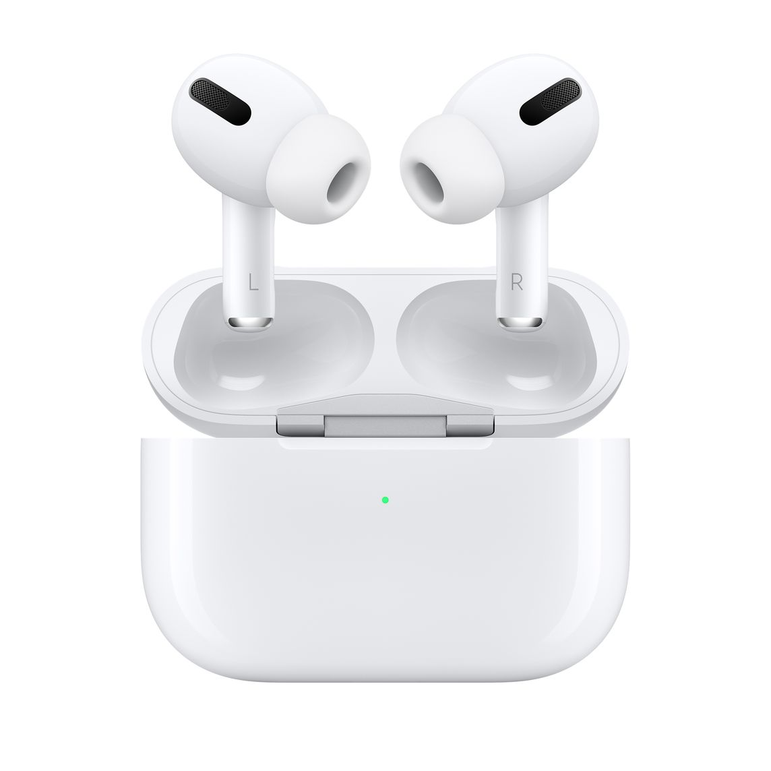
Prizes – 3rd Place
Apple Airpod Pros

Slide 8
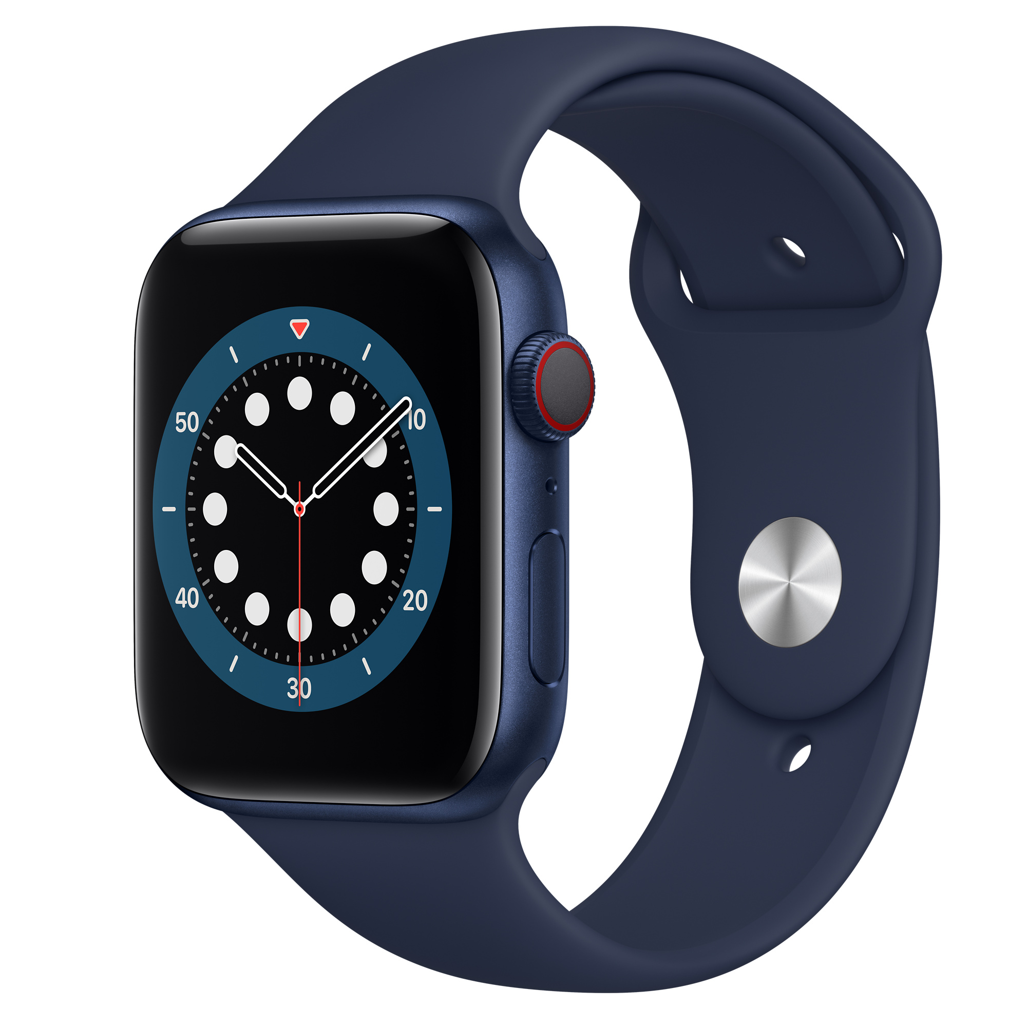
Prizes – 2nd Place
Apple Watch Series 6

Slide 9

Prizes – 1st Place
4th Generation iPad Air

